Slide 1
Algorithm
(Recursive Time Complexity)

Slide 2
Solving Recurrences- Methods
Iteration Method
Recursion Tree Method
Master Theorem

Slide 3
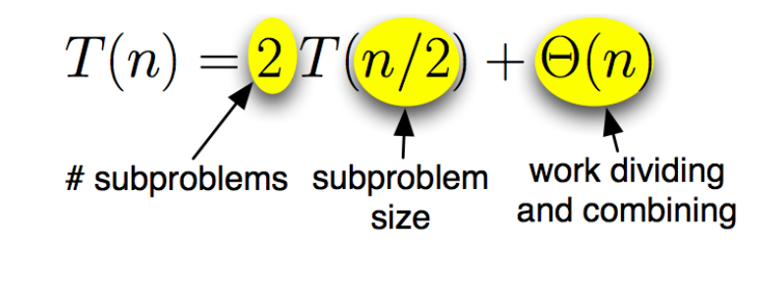
Merge Sort: Running Time

Slide 4
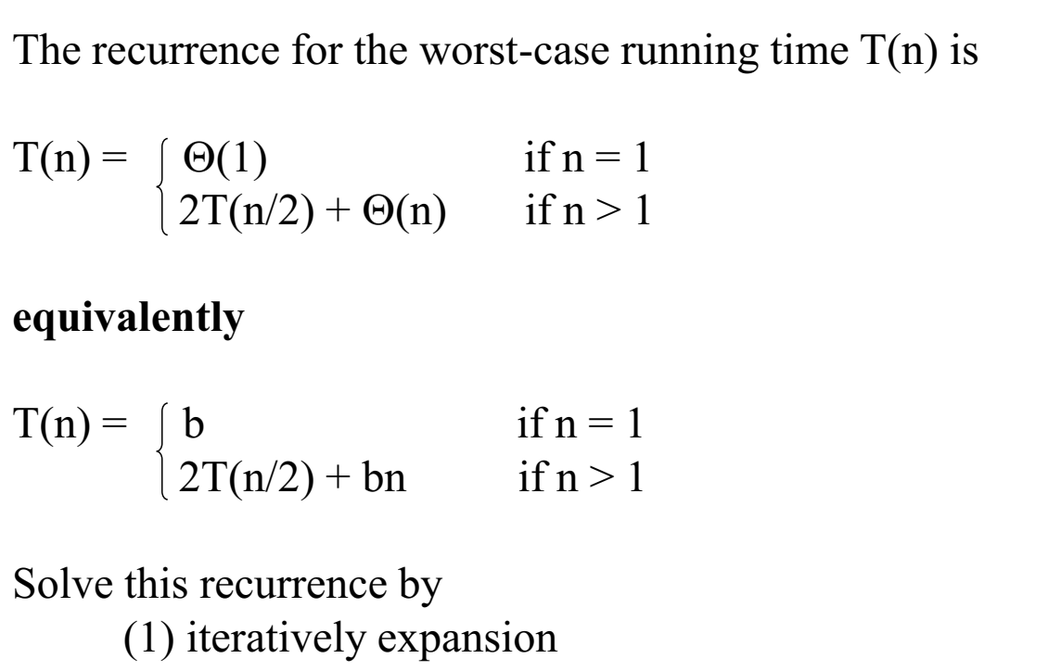
Merge Sort: Running Time
The number of element is 1

Slide 5
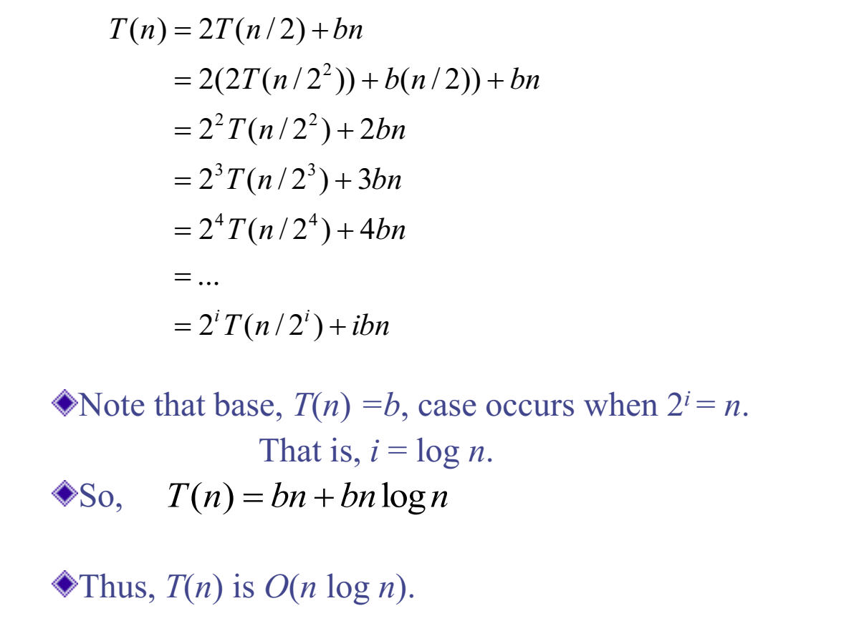
Merge Sort: Running Time
Refer to the additional material, the detailed derivation of this running time is explained well!

Slide 6
Iteration Method
Try:
T(n) = 4T(n/2) + bn
T(n) = 3T(n/2) + bn

Slide 7
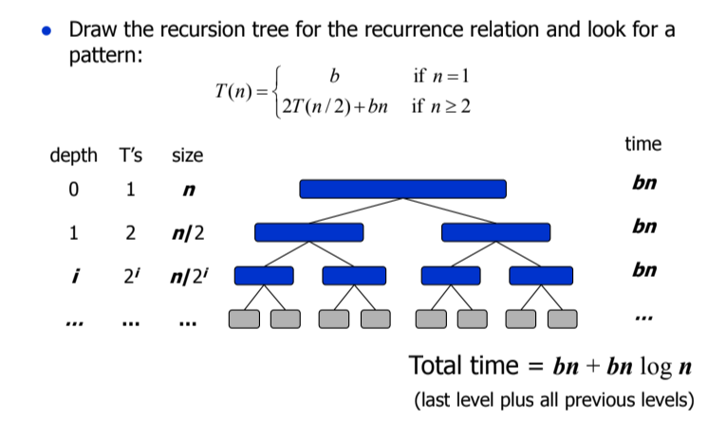
Recursion Tree Method
Refer to the additional material, the detailed derivation of this running time is explained well!

Slide 8
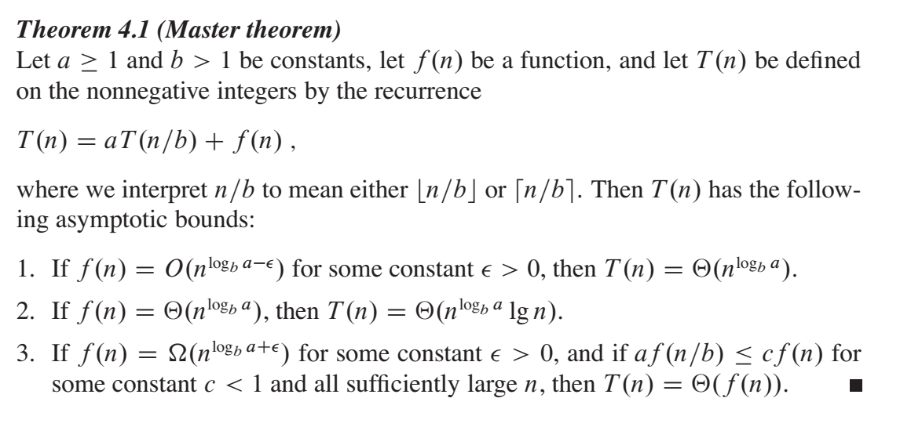
Master Theorem

Slide 9
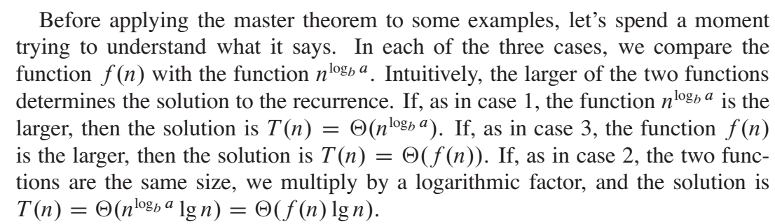
Master Theorem

Slide 10
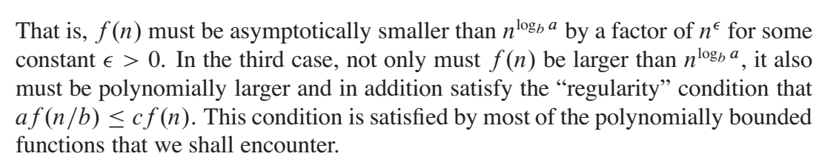
Master Theorem

Slide 11

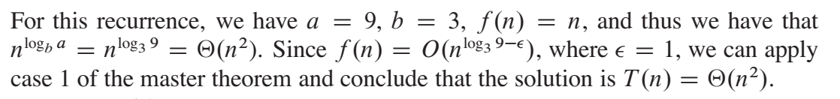
Master Theorem - Case 1 Example

Slide 12
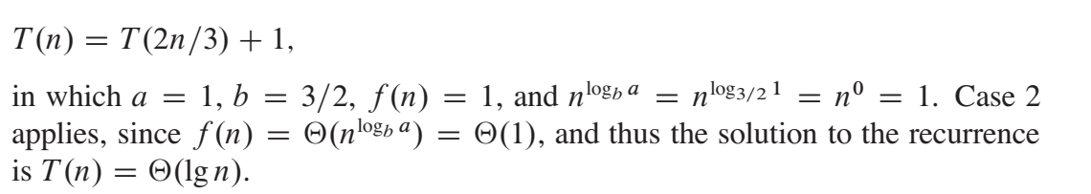
Master Theorem - Case 2 Example

Slide 13
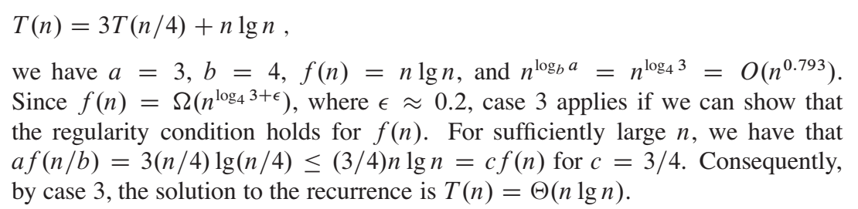
Master Theorem - Case 3 Example

Slide 14
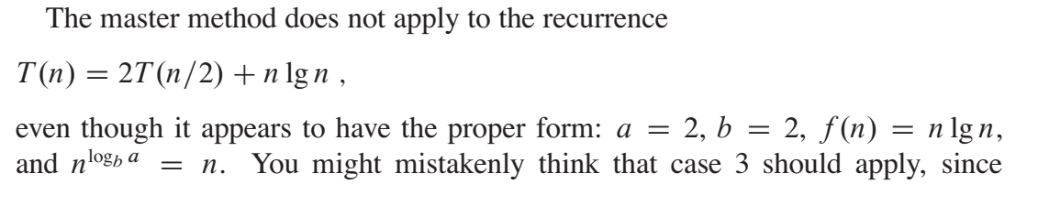
Master Theorem

Slide 15
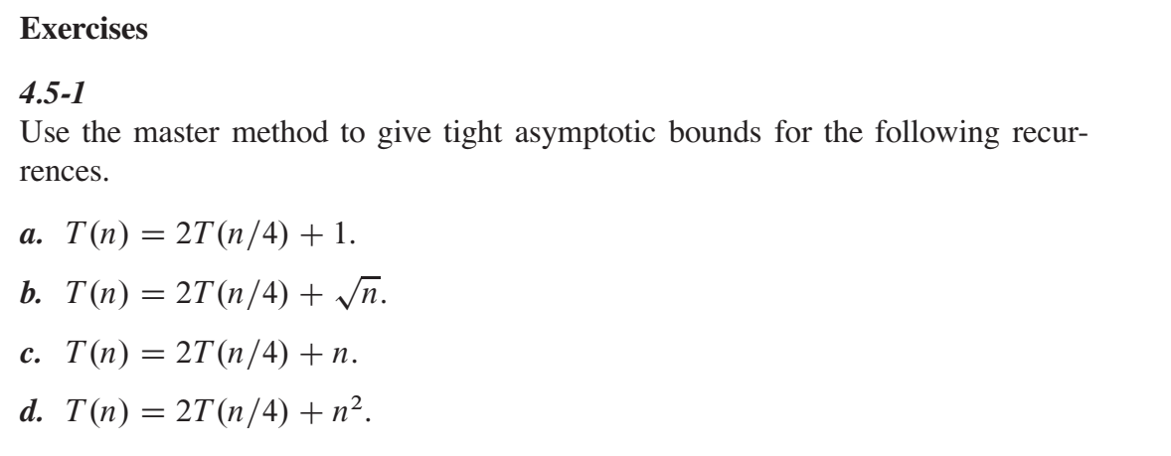
Master Theorem

